Slide 1
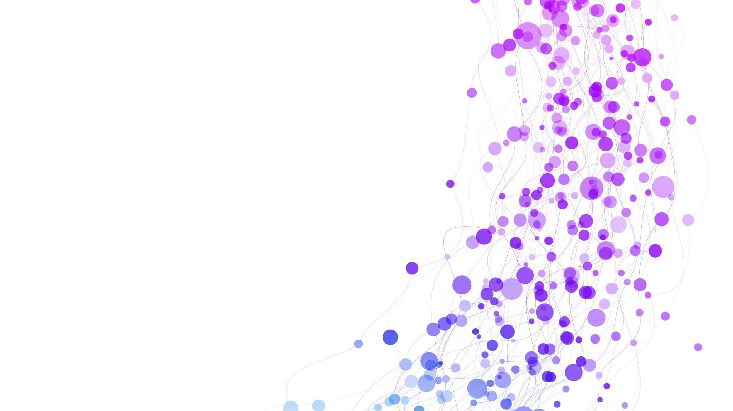
Spatiotemporal Non-Uniformity-Aware Online Task Scheduling in Collaborative Edge Computing for IIoT
Team: Thing Different - 02
Authors: Yang Li, Xing Zhang, Yukun Sun, Wenbo Wang, Bo Lei
IEEE Transactions on Mobile Computing
CB.SC.U4CSE23105 - Amrith
CB.SC.U4CSE23142 - S Ajeth
CB.SC.U4CSE23145 - Sarvesha
CB.SC.U4CSE23157 - Varun

Slide 2

Problem Understanding
Imagine an oil factory with multiple units, each having multiple pipelines and an edge server. Normally, sensor readings are taken every 10 seconds. However, if an anomaly is detected, the frequency of data collection from a specific pipeline is dramatically increased.
Temporal Non-Uniformity: A sudden, high-frequency data burst from one unit (change over time).
Spatial Non-Uniformity: An overloaded edge server in the leaking unit, while others are underutilized (uneven distribution across locations).

Slide 3


Why it is an Edge Problem
Starting with the Cloud
The Initial Thought: The cloud seems like an obvious solution due to its vast, seemingly infinite resources for computation and storage.
Benefits: It's great for tasks that aren't time-sensitive, like long-term data analysis, training large AI models, and acting as a robust backup for the entire system.
Why Cloud Isn't Feasible for Real-Time Tasks
High Latency: For critical, real-time tasks like anomaly detection, the delay in sending data to a distant cloud server is simply too long and could lead to significant operational failures.
Privacy & Security: Many industrial applications have strict regulations that prevent sensitive data from leaving the local factory network.
Cost & Bandwidth: Continuously sending the massive volume of data generated by IIoT devices to the cloud can be very expensive and strain network bandwidth.
Why Edge Is the Perfect Solution
Low Latency: Edge servers are located on-site, allowing for near-instantaneous data processing. This enables real-time decisions and automated responses critical for safety and efficiency.
Data Security: Data processing remains within the private, local network, satisfying all privacy and security requirements.
Cost-Effective: Edge computing handles the bulk of the data locally, reducing the need for costly and bandwidth-intensive data transfers to the cloud.

Slide 4
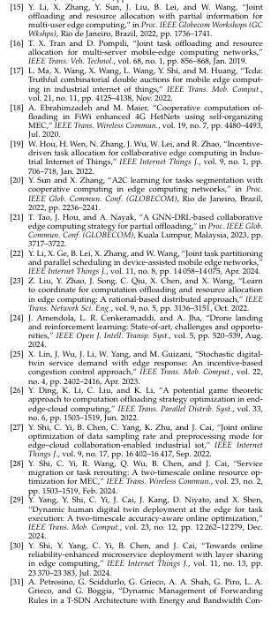
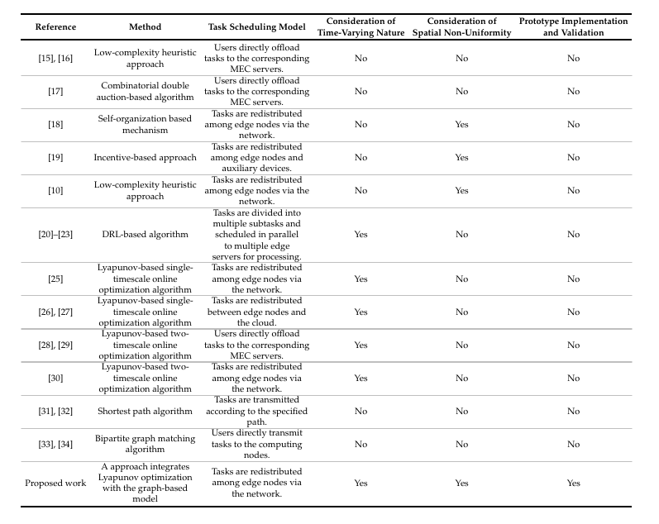
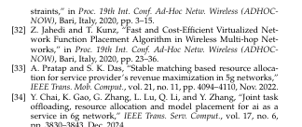
State of Art Literature Survey

Slide 5

State of the Art Literature Survey Contd.
Single-Node Focus: Many existing studies assume end devices can offload tasks directly to all edge nodes, neglecting the reality that tasks must be redistributed via the network between collaborating edge nodes. - [15][16][17]
Short-Term Performance: Research on collaborative offloading often focuses on short-term gains, ignoring the long-term effects of time-varying request distributions on overall costs and performance. - [18][19]
DRL Drawbacks: While Deep Reinforcement Learning (DRL) is a popular approach, it suffers from significant issues for critical IIoT applications. Its training process is prone to instability and oscillations, and as a "black box" model, it lacks strict performance guarantees. -[20][21][23]
Lyapunov Limitations: Existing Lyapunov-based methods primarily focus on either spatial or temporal respectively and cannot be directly applied to problems with the coupled spatial and temporal dimensions present in IIoT.- [25][26][27]
Computational Cost: Other approaches, particularly those using graph models, often suffer from high computational costs that make them impractical for large-scale, real-time IIoT environments. - [31][33]
Lack of Real-World Validation: A critical gap is the absence of demonstrated superior performance in real engineering applications, as many solutions are difficult to implement in practice.

Slide 6
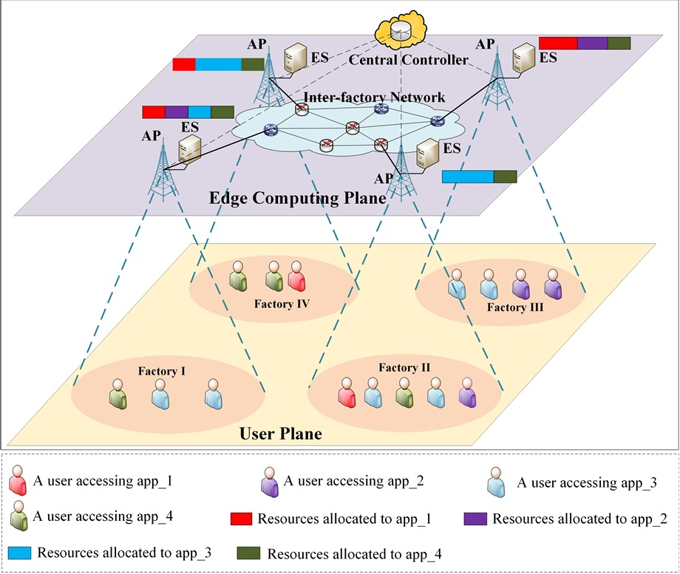
Architecture Overview
1. User Plane: IIoT Devices What it is: Data sources like sensors, robots, and smart machines in factories. What it does: Generate real-time data and send service requests to the nearest Access Point (AP).
2. Edge Computing Plane: Local Network What it is: Each factory’s AP and Edge Server (ES), connected to other factories. What it does: AP handles requests; With the help of Central Controller, decision is made to process the request in the same ES or offload it elsewhere
3. Central Controller: The Brain What it is: The system’s decision-making core. What it does: Monitors system status and adjusts task scheduling in real time, instructing APs where to route tasks—separating resource allocation from scheduling.

Slide 7
Contribution of this paper
1. Problem Formulation & Online Optimization
Dynamic Task Scheduling: The paper formulates the dynamic task scheduling in collaborative edge computing as a stochastic optimization problem.
Long-Term Goals: It aims to optimize long-term average task processing delay under a constraint of long-term operational cost.
Online Decision-Making: It employs Lyapunov optimization to make real-time scheduling decisions without needing prior knowledge of future system states.
2. Novel Solution Approach
Graph Model Integration: A graph model is introduced to guide optimal task scheduling decisions, especially for the NP-hard subproblems derived from Lyapunov optimization.
Two-Stage Heuristic Algorithm: A two-stage heuristic algorithm is developed to find near-optimal solutions efficiently.
Imitation Learning for Acceleration: An imitation learning-based scheme is developed to further reduce the algorithm's execution time, enhancing scalability.

Slide 8
The Role of Lyapunov Optimization:
Purpose: A mathematical tool for solving stochastic optimization problems in unpredictable systems¹. It helps achieve long-term goals, like adhering to a budget, by guiding real-time, short-term decisions, such as minimizing delay.
Mechanism: It transforms a long-term problem into a series of real-time, single-slot problems. It does this by creating a "virtual queue" that tracks the long-term cost constraint. The algorithm's job is to make decisions in each time slot to keep this queue stable.
Why it fits IIoT: The IIoT environment is highly dynamic and stochastic, making traditional methods that require forecasting future events impractical. Lyapunov optimization is proactive and adaptive, making it a crucial capability for real-time industrial applications.
Workflow (per time slot):
Observe: It senses the current system state, including new requests and the virtual queue backlog.
Solve: It finds the best scheduling decision for that specific time slot by solving the real-time sub-problem.
Update: It updates the virtual queue based on the cost of the decision.
Advance: The process repeats for the next time slot.

Slide 9
Heuristic-Based Hierarchical Optimization
General Use
What it is: A strategy that breaks down a complex, difficult problem into smaller, more manageable sub-problems to find a quick, effective solution.
Why it's used: It's a pragmatic way to solve NP-hard problems, which are too slow to solve perfectly.
Specific Use in this Research
How it's used here: A two-step process to solve the NP-hard task scheduling problem:
Step 1: A discrete particle swarm algorithm (PSO) classifies factories as a source, sink, or isolated node. This dramatically simplifies the problem.
Step 2: A harmony search (HS) algorithm then determines the specific number of tasks to be forwarded between the classified nodes.
The result: This approach finds an efficient, near-optimal scheduling decision in real time, making the problem solvable for practical IIoT deployments.

Slide 10
Low-Complexity Acceleration with Imitation Learning
General Use
What it is: A machine learning strategy where an agent learns to perform a task by mimicking an expert's behavior, rather than learning through trial and error.
Why it's used: It is highly effective for reducing computational complexity and improving scalability, especially in systems where real-time decisions are critical and a slower, more complex "expert" algorithm already exists.
Specific Use in this Research
How it's used here: The project's more complex Heuristic-Based Hierarchical (HH) algorithm acts as the "expert." An Imitation Learning (IL) model, built with a Graph Neural Network (GNN), is trained to mimic the HH algorithm's high-level category assignment decisions.
The result: This allows the system to make decisions with a significant reduction in runtime, making the solution practical and scalable for large-scale IIoT deployments where low-latency responsiveness is a priority.

Slide 11
Implementation strategy
Codebase: GitHub repository provided in the paper
Programming Language: Python
Core Libraries: PyTorch
Simulation Environment: PyTorch
1. Environment Setup:
Setup the necessary python environment with PyTorch
2. Scenario Formulation:
Simulations to be formulated to test the system's behavior, including:
Trade-off Analysis: We will vary the V parameter(prioritization between delay and cost) to demonstrate the balance between delay and cost.
Scalability Test: Increase the number of factories to validate the scalability and runtime efficiency of both the HH and IL models, and to show where the IL model becomes more practical.
Comparative Analysis: Run various benchmark algorithms to compare their performance against both the HH and IL models on metrics like delay, cost, and runtime.
3. Simulation & Validation :
The simulation will use the pre-trained models to execute the formulated scenarios.
Performance Metrics:
Average Task Processing Delay(ms): Measures the quality of service by calculating the average time from task arrival to completion.
Long-Term Average Task Processing Cost(J): Measures the total operational cost over time to ensure adherence to the budget.
Computational Running Time(ms): Evaluates the scalability and real-time feasibility of the algorithms as the network size changes.
Virtual Queue Backlog(J): Used to demonstrate the algorithm's stability and its ability to effectively control the long-term cost constraint.
Weighted Sum of Normalized Delay and Overrun Cost: A combined metric that shows the tunable balance between performance and cost.

Slide 12

Phase two Plan
Amrith: Exploration of different practical use case of this paper, & study Heuristic based Search Algorithm
Varun: study of Lyapunov Optimization Algorithm
Ajeth: Simulator Setup
Sarvesha: Experiment Design and Analysis

